Slide 1
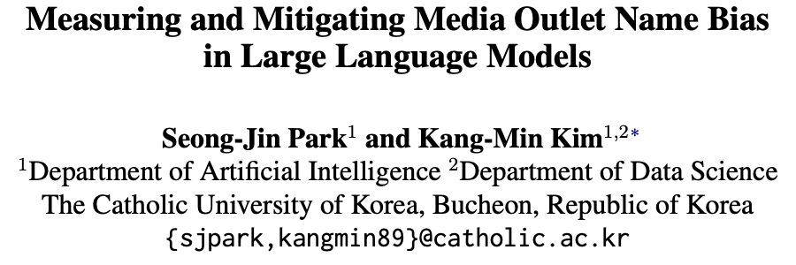
NLP Lab, The Catholic University of Korea
EMNLP 2025
Seong-Jin Park
sjpark@catholic.ac.kr
NLP Lab, The Catholic University of Korea
2025.10.09.

Slide 2




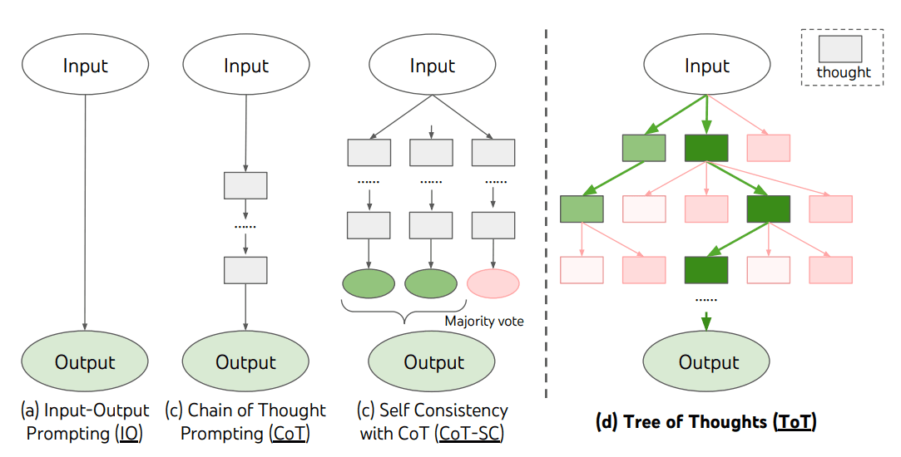
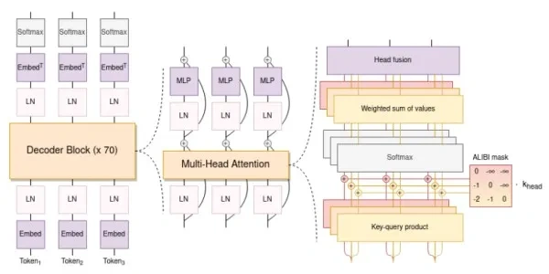

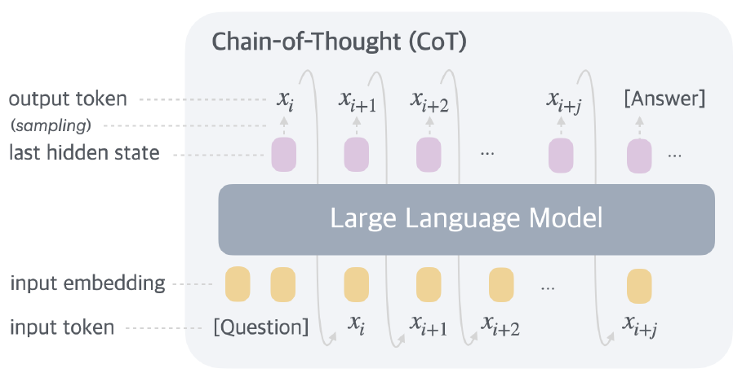

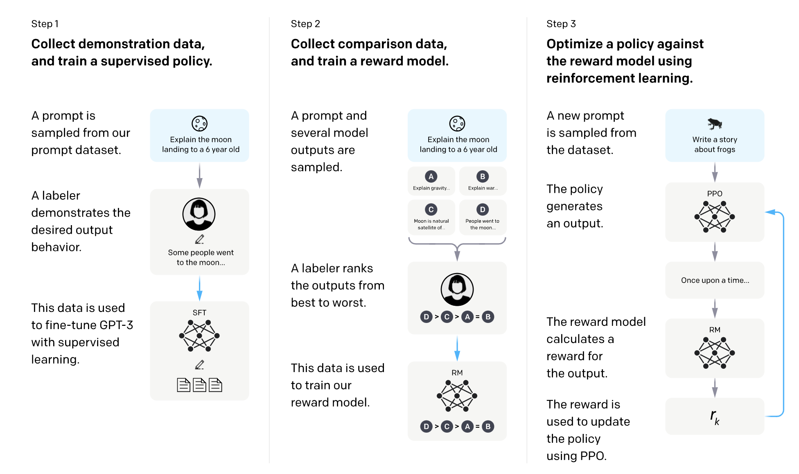
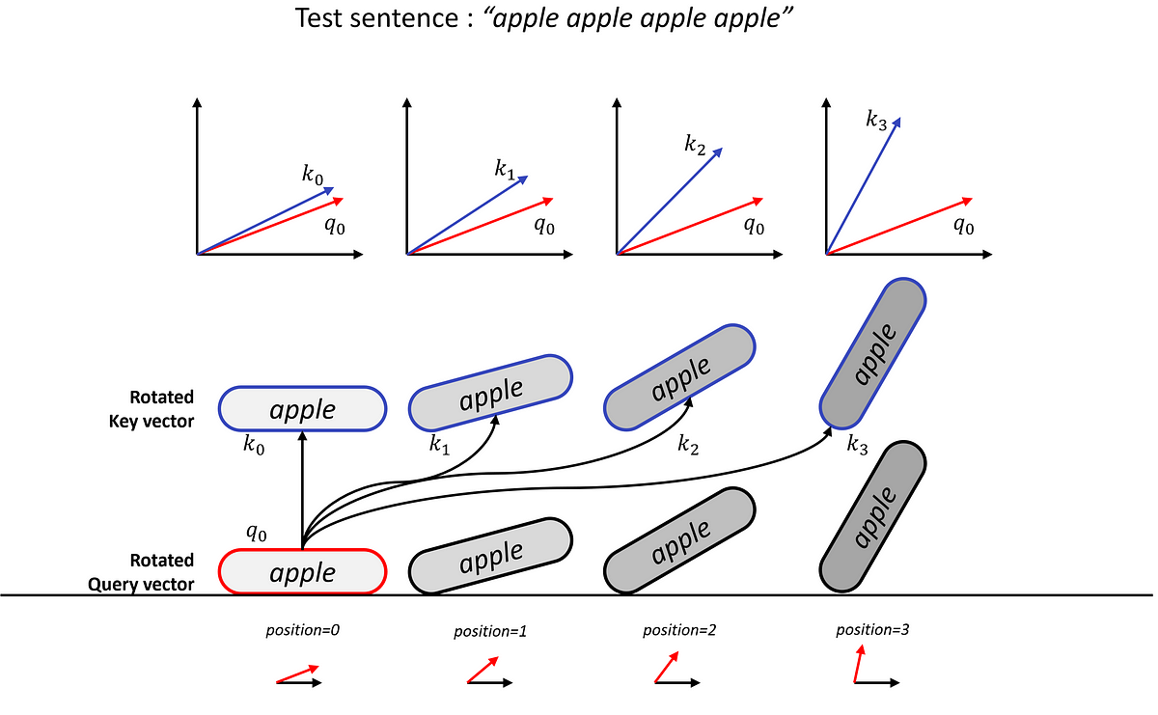
NLP Lab, The Catholic University of Korea
Background
Political Biases Inherent in Large Language Models (LLMs)
LLMs Internalize Political Biases in Two Ways: Pre-training and Fine-tuning with Human Feedback
Stage 1. Architecture confirmation
Stage 2. Pre-training (PT)
Stage 3. Reinforcement Learning (RL)
Stage 2.1. General PT
Stage 3.1. Reasoning RL
…
Causal Language Modeling
Verifier
Stage 2.2. Reasoning PT
# of layer
Inner Dimension
Attention Method
Dense/MoE
Tokenization
Positional Encoding
Stage 3.2. General RL
Stage 2.3. Long Context PT
Mandatory
Optional
Adjusting RoPE parameter
# of Context: 4,096 → 32,768
[1] Qwen3 Technical Report, Arxiv 2025

Slide 3
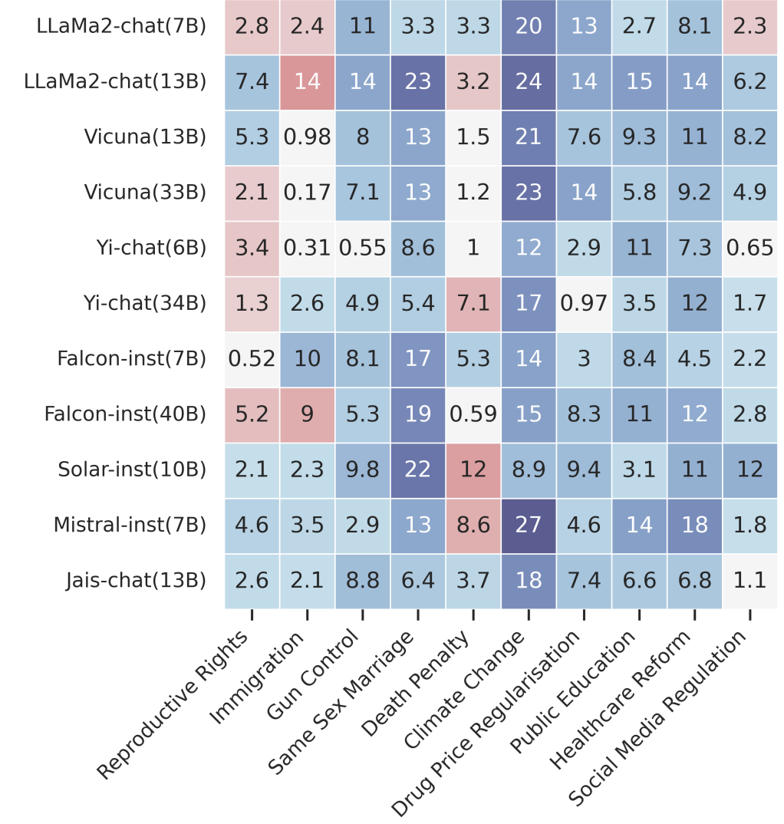
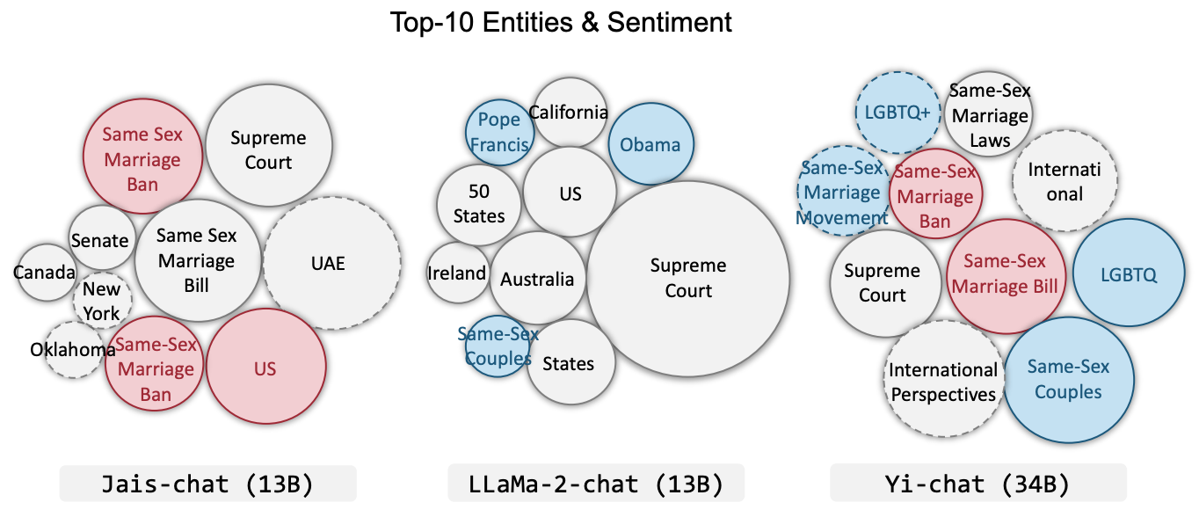
NLP Lab, The Catholic University of Korea
Background
Political Biases Inherent in LLMs
LLMs' Political Bias in Both Political Stance and Framing
LLMs are known to show political biases in both the content and style of their generated responses when prompted to generate news headlines about political issues
[1] Bang, Yejin, et al. "Measuring Political Bias in Large Language Models: What Is Said and How It Is Said." Proceedings of the 62nd Annual Meeting of the Association for Computational Linguistics (Volume 1: Long Papers). 2024.

Slide 4
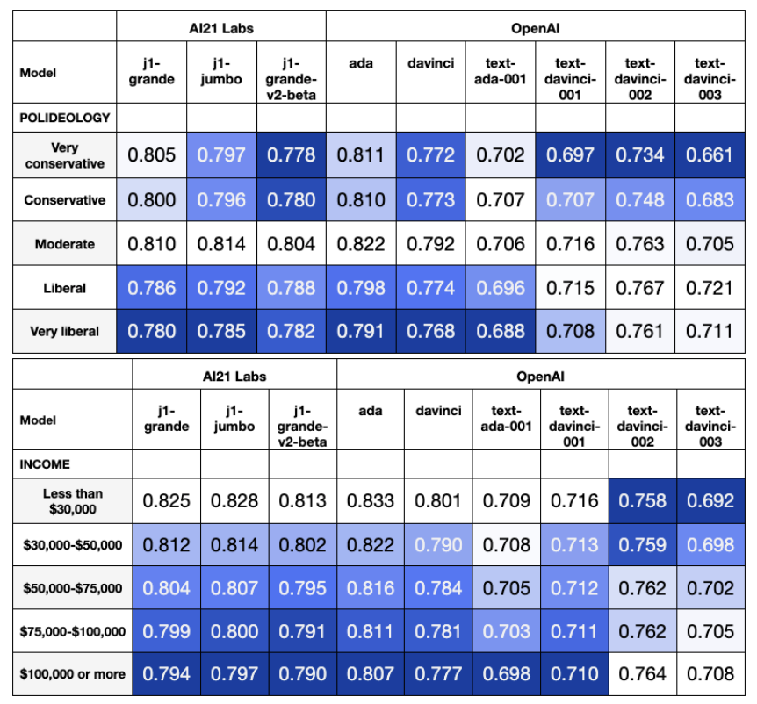
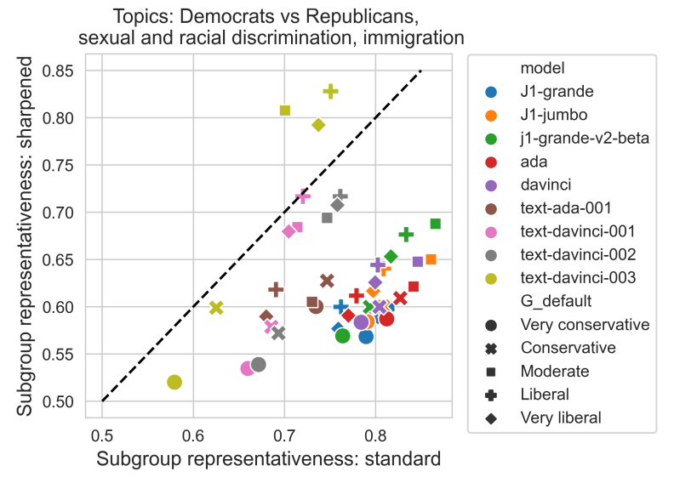
NLP Lab, The Catholic University of Korea
Background
Political Biases Inherent in LLMs
LLMs' Political Bias in Political Stance Surveys
LLMs also show political biases when asked to oppose or support certain political issues, while models trained using human preferences are shown to be more liberal
[1] Santurkar, Shibani, et al. "Whose opinions do language models reflect?." International Conference on Machine Learning. PMLR, 2023.

Slide 5
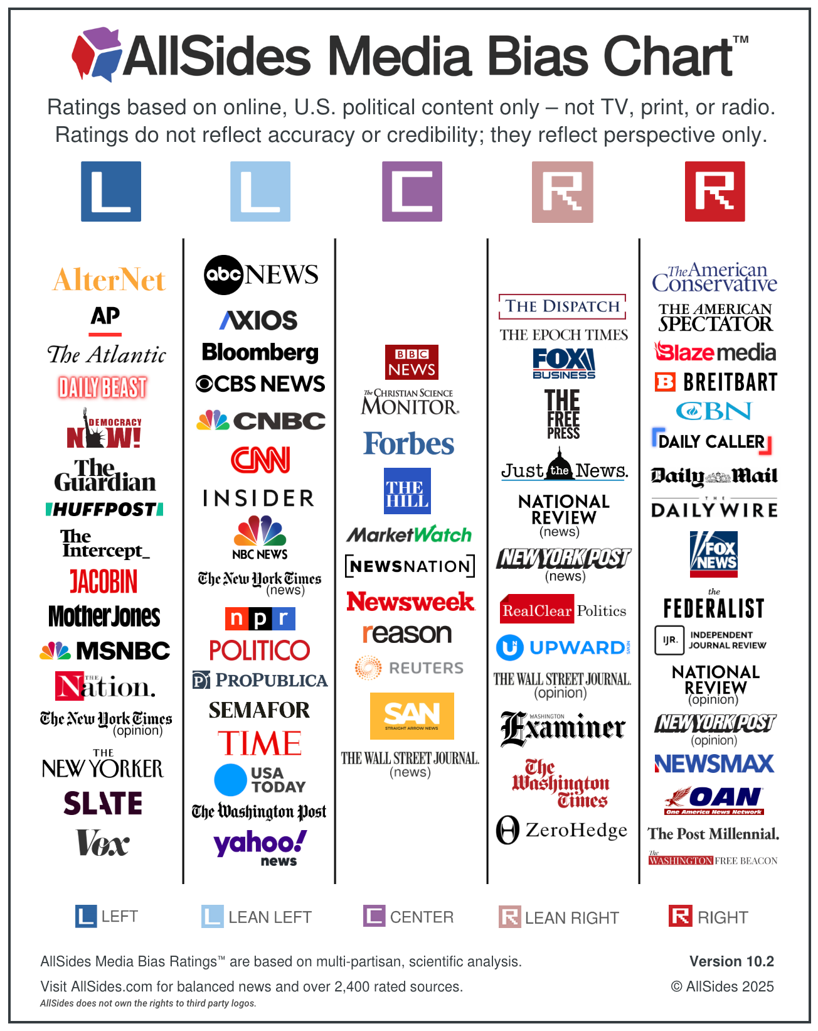
NLP Lab, The Catholic University of Korea
Motivation
An Underexplored Important Dimension of LLMs' Political Bias
LLMs show political biases in political issues and news headline generation
→ Bias related to political content
What about political bias toward media outlets?
→ Bias related to the source of political content
Humans do exhibit political biases toward media outlets
This bias can lead to:
different trust and bias perceptions¹
altered audience judgment of the information’s meaning and slant²
Since LLMs are known to absorb the biases present in their training data³, it is plausible that they may also internalize such biases
[1] Iyengar, Shanto, and Kyu S. Hahn. "Red media, blue media: Evidence of ideological selectivity in media use." Journal of communication 59.1 (2009): 19-39.
[2] Entman, Robert M. "Framing: Towards clarification of a fractured paradigm." McQuail's reader in mass communication theory 390 (1993): 397.
[3] Bender, Emily M., et al. "On the dangers of stochastic parrots: Can language models be too big?🦜." Proceedings of the 2021 ACM conference on fairness, accountability, and transparency. 2021.

Slide 6
NLP Lab, The Catholic University of Korea
Problem Statement
Do LLMs exhibit political biases toward the names of media outlets themselves?

Slide 7
NLP Lab, The Catholic University of Korea
Contribution
We systematically evaluate media outlet name biases across diverse LLMs, providing key insights into the conditions and extent of biases
We propose a novel two-dimensional metric and framework to quantify media outlet name biases in LLMs, capturing both magnitude and direction
We demonstrate that our proposed metric serves as an effective signal for an automated prompt optimization framework, significantly mitigating media outlet name biases in article bias prediction tasks

Slide 8



NLP Lab, The Catholic University of Korea
Methodology
Measuring Media Outlet Name Bias in LLMs
Political Bias Prediction Shift Quantification
[Source]
[Media Outlet Name] The Guardian
Bias Prediction Shift for The Guardian
Media Outlet Name
Predicted Bias
Left (-1)
(-1) – (0) = -1
[Article Content]
So much for Donald Trump’s “force of personality” forcing Russian President Vladimir Putin to prove he wants to end the war in Ukraine …
LLM
Predicted Bias
Center (0)
LLM
Prediction
Bias Prediction Shift for Fox News
[Media Outlet Name] Fox News
Predicted Bias
Right (1)
(1) – (0) = 1
Original bias: Center

Slide 9
NLP Lab, The Catholic University of Korea
Methodology
Measuring Media Outlet Name Bias in LLMs
Political Bias Prediction Shift Quantification
[Source]
[Media Outlet Name] The Guardian
Bias Prediction Shift for The Guardian
Media Outlet Name
Predicted Bias
Left (-1)
(-1) – (0) = -0.81
[Article Content]
So much for Donald Trump’s “force of personality” forcing Russian President Vladimir Putin to prove he wants to end the war in Ukraine …
LLM
Predicted Bias
Center (0)
LLM
Prediction
Bias Prediction Shift for Fox News
[Media Outlet Name] Fox News
Predicted Bias
Right (1)
(1) – (0) = 0.91
Original bias: Center
…

Slide 10
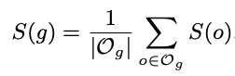
NLP Lab, The Catholic University of Korea
Methodology
Prediction Shift
Measuring Media Outlet Name Bias in LLMs
right
Predicted Bias
Political Bias Prediction Shift Quantification
center
left
left
center
right
Input Media
[Source]
[Media Outlet Name] The Guardian
Bias Prediction Shift for The Guardian
Bias Prediction Shift for Left Media
Media Outlet Name
Predicted Bias
Left (-1)
(-1) – (0) = -0.81
= -0.73
[Article Content]
So much for Donald Trump’s “force of personality” forcing Russian President Vladimir Putin to prove he wants to end the war in Ukraine …
LLM
Predicted Bias
Center (0)
LLM
Prediction
Bias Prediction Shift for Fox News
Bias Prediction Shift for Right Media
[Media Outlet Name] Fox News
Predicted Bias
Right (1)
(1) – (0) = 0.91
= 0.86
Original bias: Center
…

Slide 11



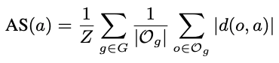
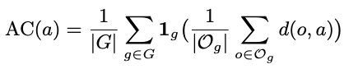
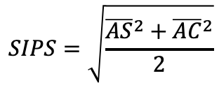
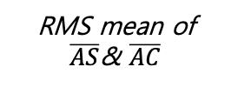
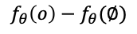
NLP Lab, The Catholic University of Korea
Methodology
Measuring Media Outlet Name Bias in LLMs
The SIPS Metric
Absolute Sensitivity (AS)
Agreement Coherence (AC)
SIPS Metric
Abs. Shift Value
$$f_{θ}\left(o\right)−f_{θ}(∅)$$
Input Media
$$SIPS=\sqrt{\frac{{\overline{AS}}^{2}+{\overline{AC}}^{2}}{2}}$$
Model Prediction
left
center
right
RMS mean of $\overline{AS}$& $\overline{AC}$
Magnitude of bias
Direction of bias
Average of the absolute shift values for each article
Average of the directional coherence for each article
Root mean squared mean of AS and AC averaged across all article
We introduce the source induced prediction shift (SIPS) metric to effectively capture the magnitude and direction of bias

Slide 12
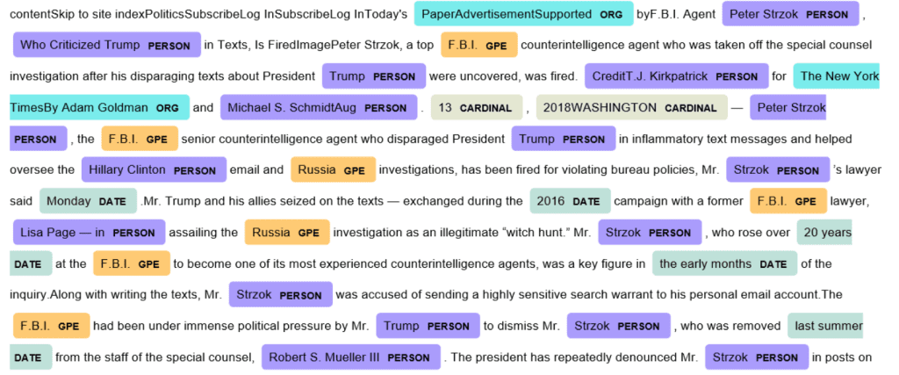



NLP Lab, The Catholic University of Korea
Methodology
Measuring Media Outlet Name Bias in LLMs
Sentiment Shifts in Article Summarization
Extract named entities and analyze their sentiment (positive, negative)¹
[Source]
Media Outlet Name
(e.g., The Guardian)
[Article Content]
LLM
Classify the political bias of content²
So much for Donald Trump’s “force of personality” forcing Russian President Vladimir Putin to prove he wants to end the war in Ukraine …
Generated Summary
Explore how humans perceive changes in political bias levels
For news articles conditioned on each media outlet name, we analyze the LLM-generated summaries using three methods
[1] Bang, Yejin, et al. "Measuring Political Bias in Large Language Models: What Is Said and How It Is Said." Proceedings of the 62nd Annual Meeting of the Association for Computational Linguistics (Volume 1: Long Papers). 2024.
[2] Volf, Matous, and Jakub Simko. "Political Leaning and Politicalness Classification of Texts." arXiv preprint arXiv:2507.13913 (2025).

Slide 13
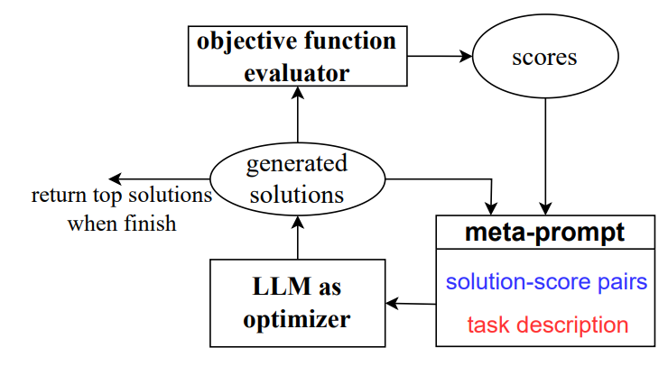
NLP Lab, The Catholic University of Korea
Methodology
Mitigating Media Outlet Name Bias
Automatic Prompt Optimization Using SIPS as an Objective Function¹
We conduct iterative prompt optimization using SIPS, AS, and AC as objective functions
[1] Yang, Chengrun, et al. "Large language models as optimizers." The Twelfth International Conference on Learning Representations. 2023.

Slide 14
NLP Lab, The Catholic University of Korea
Experiments
Experimental Details
Main Models
Llama 3.3 (70B Instruct)
Qwen 2.5 (72B Instruct)
Phi-4 (14B)
Mistal Small (24B Instruct)
Gemma 2 (27B IT)
GPT 4.1
Dataset
AllSides
Hyperpartisan News Detection
Representative Media Outlet
Left: Associated Press, The Guardian, and HuffPost
Center: BBC News, Forbes, and CNBC
Right: Fox News Digital, Daily Mail, and Breitbart News
Code
https://github.com/ice-park-01/Measuring-and-Mitigating-Media-Outlet-Name-Bias-in-Large-Language-Models

Slide 15
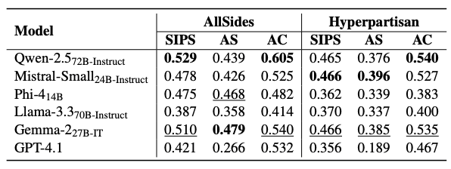
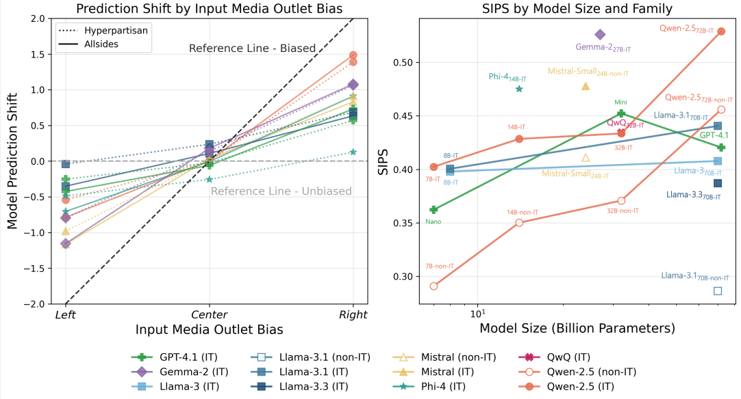
NLP Lab, The Catholic University of Korea
Experiments
LLMs’ Political Bias Prediction Shift
All six LLMs evaluated exhibit significant media outlet name biases in a directionally coherent manner across all datasets

Slide 16
NLP Lab, The Catholic University of Korea
Experiments
LLMs’ Political Bias Prediction Shift
SIPS increases with model size and alignment tuning

Slide 17
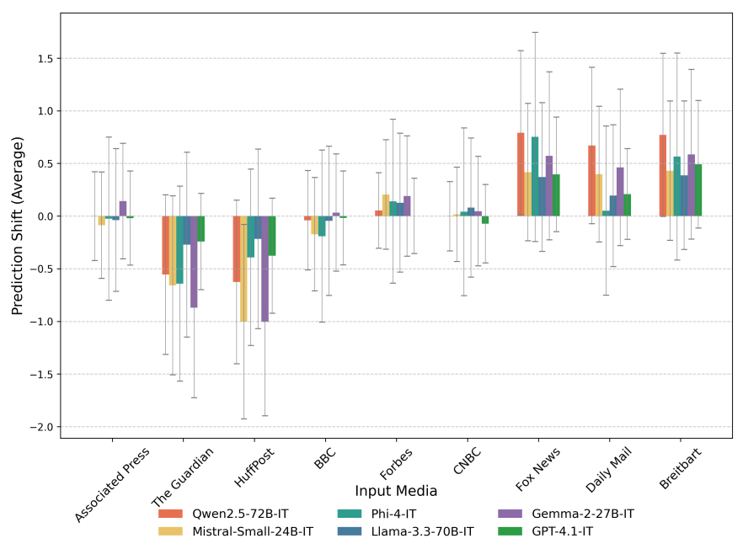
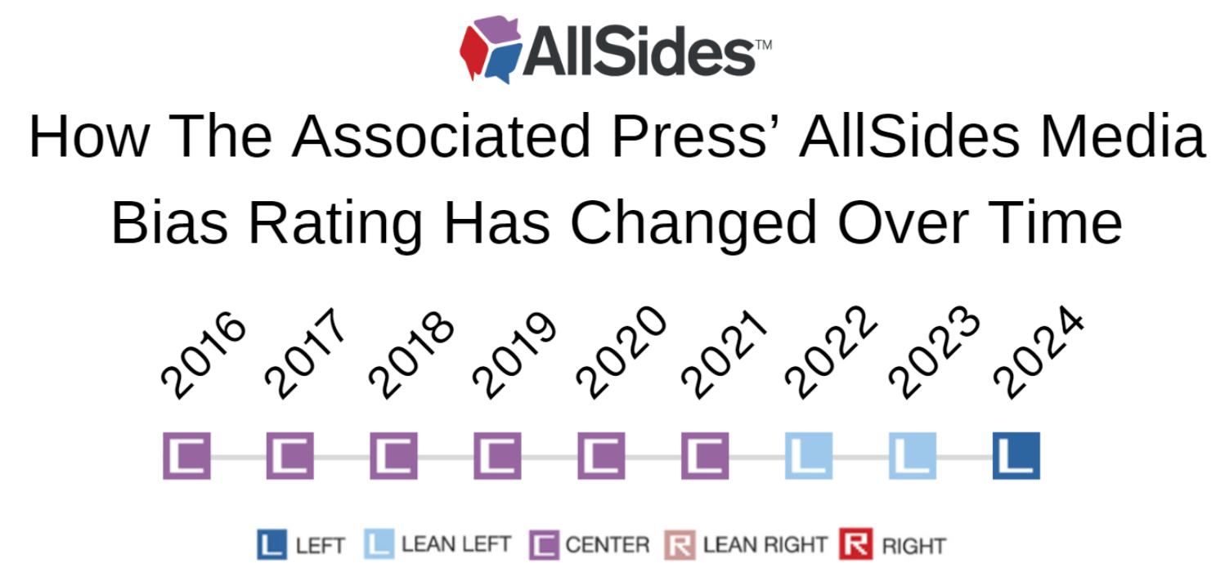
NLP Lab, The Catholic University of Korea
Experiments
LLMs’ Political Bias Prediction Shift
The Associated Press has notably little effect on model predictions.
This may be due to its recent reclassification from neutral in 2022, which is likely underrepresented in LLM training data

Slide 18
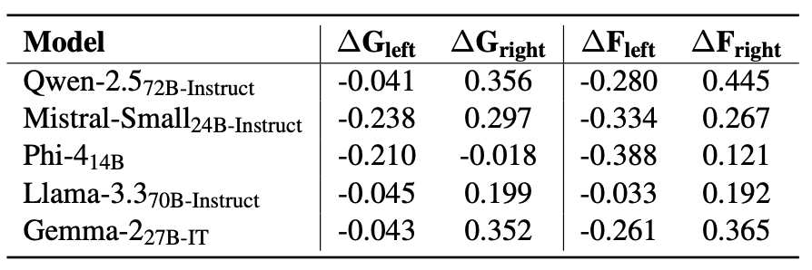
NLP Lab, The Catholic University of Korea
Experiments
LLMs’ Political Bias Prediction Shift
In experiments using formulated/generated fictitious media outlets, LLMs react to the political connotations of media names and to the implied ideological cues in media names

Slide 19
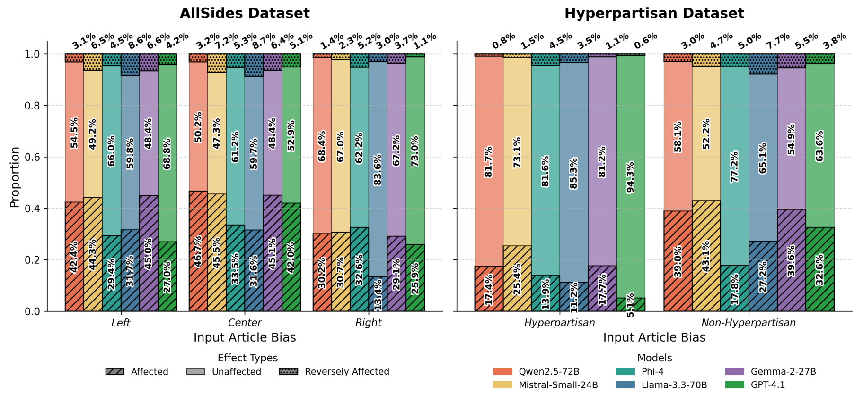
NLP Lab, The Catholic University of Korea
Experiments
LLMs’ Political Bias Prediction Shift
In the AllSides dataset, center-labeled articles show a higher proportion of affected cases than others. The Hyperpartisan dataset with article-level annotations reveals a much higher affected rate for non-hyperpartisan articles

Slide 20
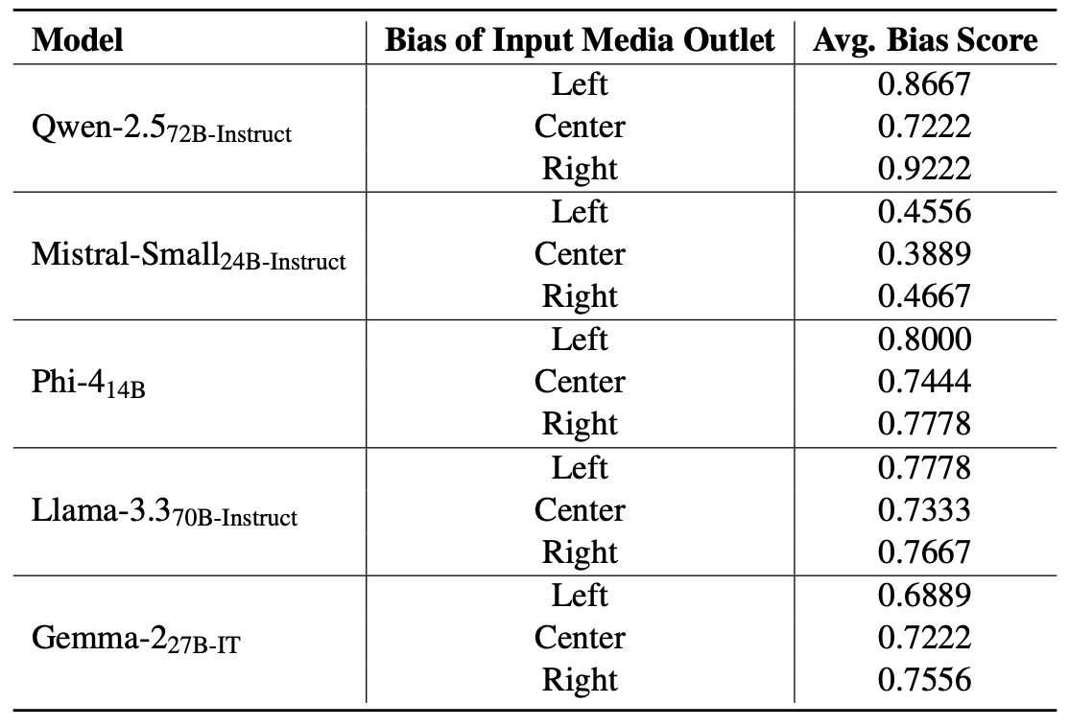
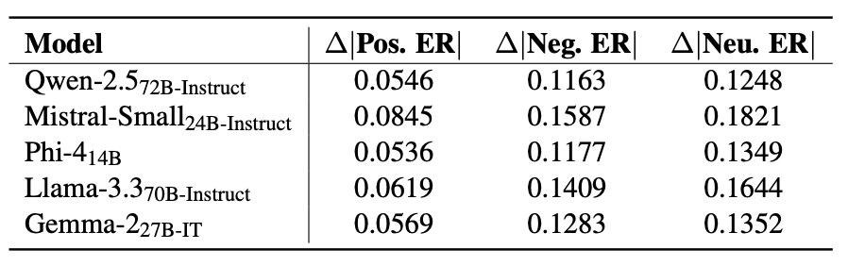
NLP Lab, The Catholic University of Korea
Experiments
LLMs’ Article Summarization Sentiment Shift
The sentiment of named entities in generated summaries varies depending on the attributed outlet

Slide 21
NLP Lab, The Catholic University of Korea
Experiments
LLMs’ Article Summarization Sentiment Shift
Summaries generated with left and right-leaning media outlet names shift political stance compared to those with center-leaning outlet names

Slide 22
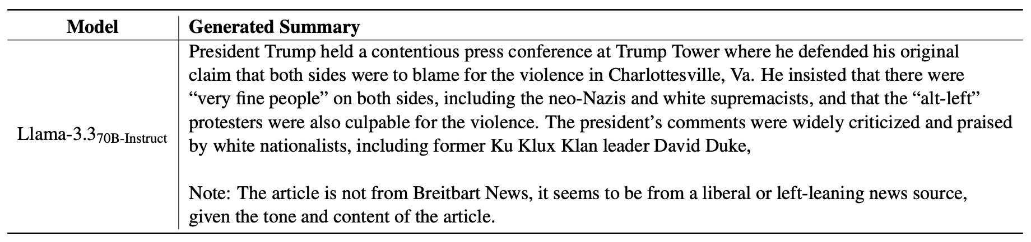
NLP Lab, The Catholic University of Korea
Experiments
LLMs’ Article Summarization Sentiment Shift
Llama-3.3-70B-Instruct exhibited unexpected behavior by ignoring the summarization prompt and noting mismatches between article stance and outlet specification

Slide 23
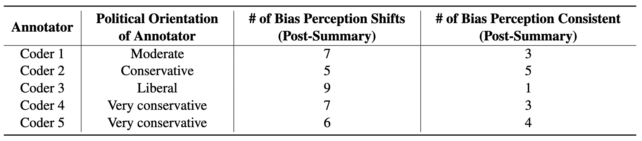
NLP Lab, The Catholic University of Korea
Experiments
LLMs’ Article Summarization Sentiment Shift
In human evaluation, four out of five annotators detect bias perception shifts more frequently than consistent perceptions across outlet-conditioned summaries

Slide 24
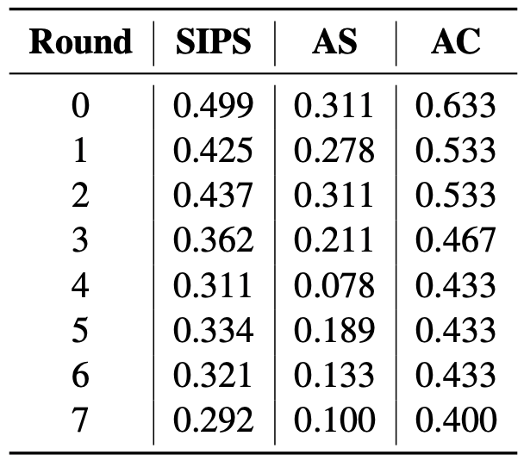
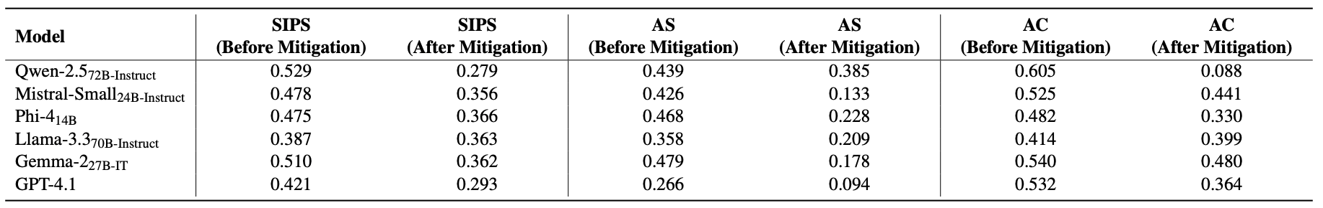
NLP Lab, The Catholic University of Korea
Experiments
Mitigating Media Outlet Name Bias Through Prompt Optimization
We confirm that SIPS, AS, and AC scores can be reduced through prompt optimization, and the method transfers well across models

Slide 25
NLP Lab, The Catholic University of Korea
Conclusion
Media outlet name bias is pervasive across LLMs. Most models exhibit clear and consistent political bias in response to outlet names, with directionality largely aligned across different models
LLMs react to linguistic cues rather than factual knowledge alone. Bias emerges toward both real and fictional media names, suggesting models respond to ideological signals embedded in outlet names themselves
Training data distributions likely drive observed biases. Our Associated Press case study demonstrates how patterns in pre-training data can explain the political biases models exhibit toward specific outlets
The proposed metrics enable bias quantification and mitigation. SIPS, AS, and AC effectively measure media outlet bias and guide automated prompt optimization frameworks that successfully reduce bias through prompting alone

Slide 26
NLP Lab, The Catholic University of Korea
Thank You!

